Slide 1
Indoor Facilities Management Analysis
Antra Tripathi

Slide 2
Index
Data Overview
Data Findings
Data Wrangling
Analysis Report
Power Bi Dashboard

Slide 3
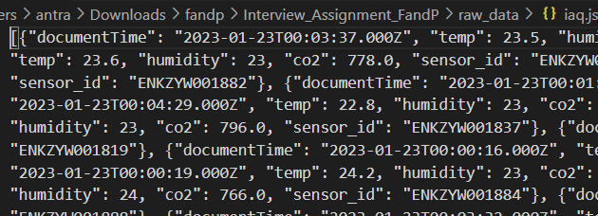
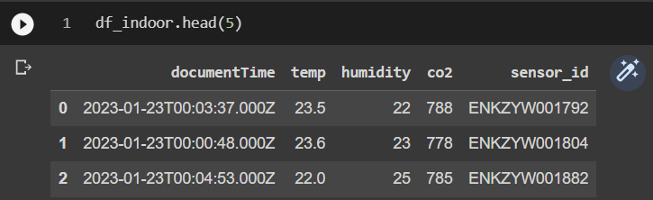
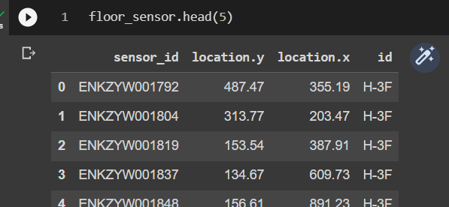
Data Overview
Original Data: Json Format
Indoor air quality data [iaq.json] : (102629, 5)
Outdoor air quality [oaq.json] : (2892, 4)
Sensor locations [floors.json] : (2, 3)
Processed Data: Pandas Dataframe and .CSV output
Loaded dated into pandas dataframe and normalized it where required
Data wrangling steps:
Datetime conversion
Creating separate date and time feature
Checking/ treating missing values
Checking for inconsistency in the data
Stats check: with respect to required operational values
Data rollup: hourly and daily basis

Slide 4
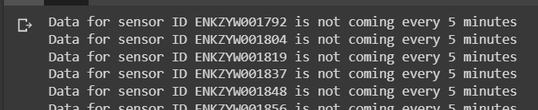
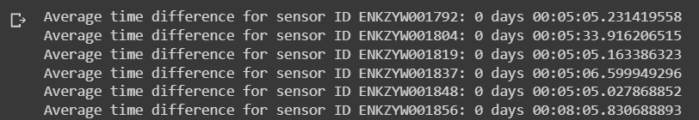
Data Findings
Missing values: 1078 missing values for wind speed in outdoor data, replaces by zero
Data Consistence:
No inconsistencies found between IAQ and floor dataframes
Data for all the sensor is not coming at exact 5 minutes,
Average time difference for outdoor data is 13 minutes
Operational Requirement check:
There are 2170 data point where temperature falls below the required operational standard, minimum being at 13 degree
There are 1267 data point where CO2 level exceeded the optimal levels with max at 1378 ppm

Slide 5



Data Wrangling
Calculating Humidity Ratio:
The humidity ratio or specific humidity is the weight of water vapour per unit weight of dry air. Humidity also affects the performance of buildings, causing condensation, mould growth, mildew, staining, slip hazards, damage to equipment and the corrosion and decay of the building fabric as well as poor performance of insulation.
Data Rollup: Hourly and Daily
Since the data is collected at interval of approx. 5mins, its recommended to aggregate data (mean) on hourly or daily basis to generate graphs and analysis patters. It also reduces noise in high volume the data.
Data Merge.
Used merge and join function of python to combine all the data where required for performing analysis and generating graphs

Slide 6
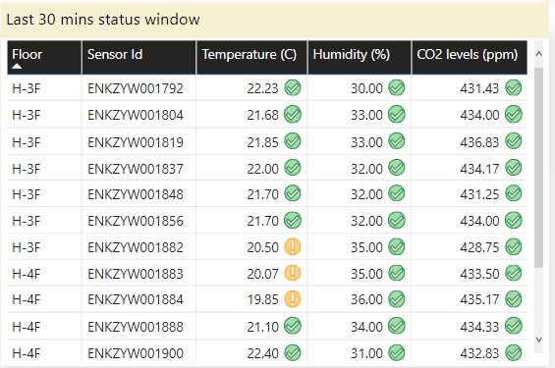
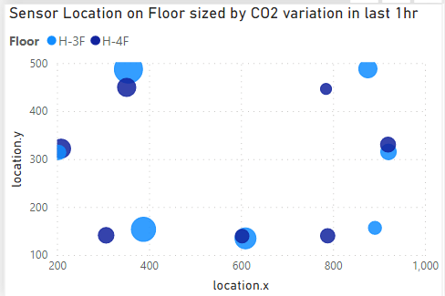
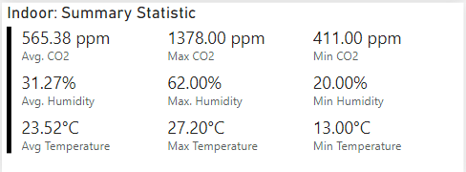
Analysis Report:
1. Indoor Air Quality (IAQ) Analysis: As the given indoor data includes indoor temperature, humidity, and CO2 levels, we can analyze the IAQ of the building. We can analyze mean and standard deviation of each sensor on both the floor. We can also identify any area that have high CO2 levels, which may indicate poor ventilation. We can suggest improving the ventilation system in those rooms to enhance the IAQ.
The temperature readings from different sensors can be compared to identify areas with a high or low temperature, and hence help to optimize heating and cooling systems

Slide 7
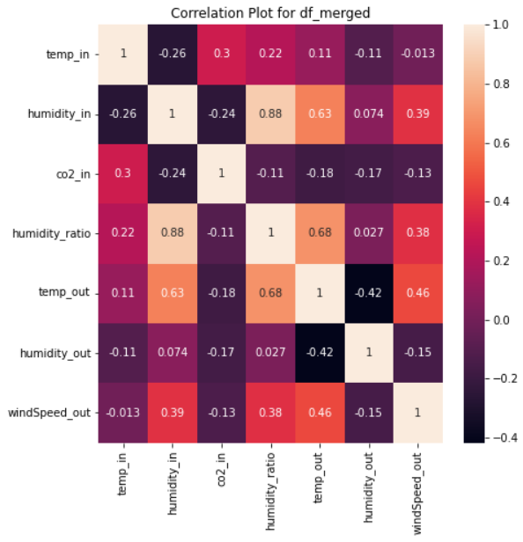
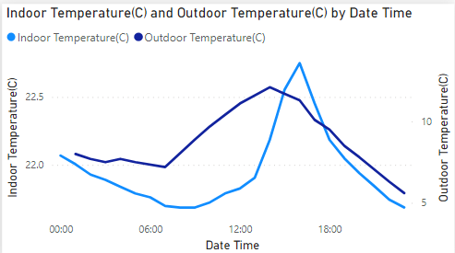
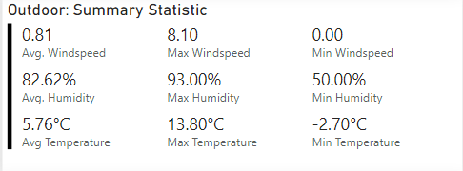
2. Outdoor Air Quality (OAQ) Analysis: We can also analyze the OAQ data and see how it affects the IAQ of the building. We can compare outdoor data with the indoor data to identify any correlations. We can also analyze the wind speed data and see how it affects the IAQ of the building, as wind speed affects the ventilation of the building.

Slide 8
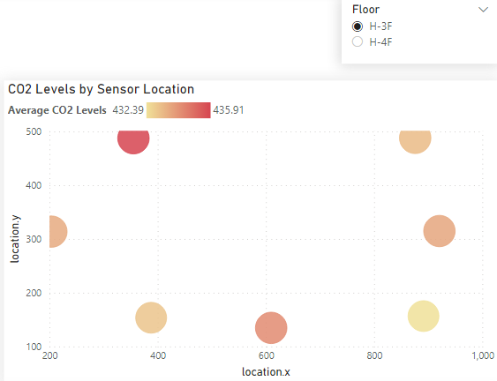
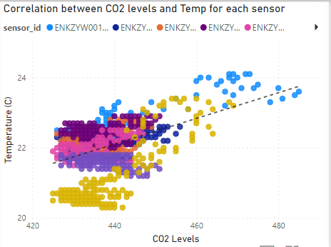
3.) Occupancy analysis: The indoor temperature and CO2 measurements can be used to estimate occupancy levels in different areas of the building. By analyzing the patterns of temperature and CO2 fluctuations, we can identify which areas are frequently occupied and which ones are not. This information can be used to optimize HVAC systems and ventilation rates.
High levels of CO2 can lead to discomfort and health problems
A positive correlation between temperature and CO2 levels, indicate indoor poor ventilation.

Slide 9
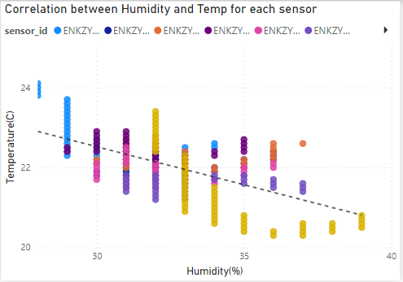
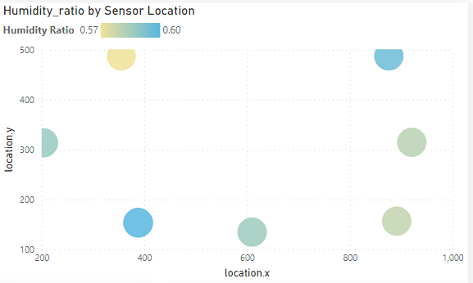
4. HVAC Analysis : The indoor temperature and humidity measurements can be used to optimize the HVAC system of the building. By analyzing the data from temperature and humidity sensors in the building, we can gain insights into how the HVAC system is performing and identify areas for improvement. For this we will look for correlations between temperature and humidity data for each sensor
Humidity ratio is the ratio of the mass of water vapor to the mass of dry air in a given air-vapor mixture. It is an important parameter in indoor environmental quality (IEQ) analysis as it affects thermal comfort, indoor air quality, and building energy performance.

Slide 10

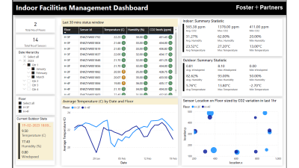
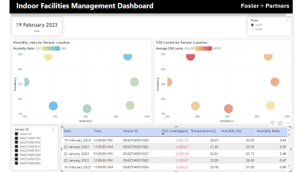
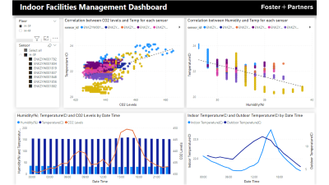
Power Bi Dashboard

Slide 11
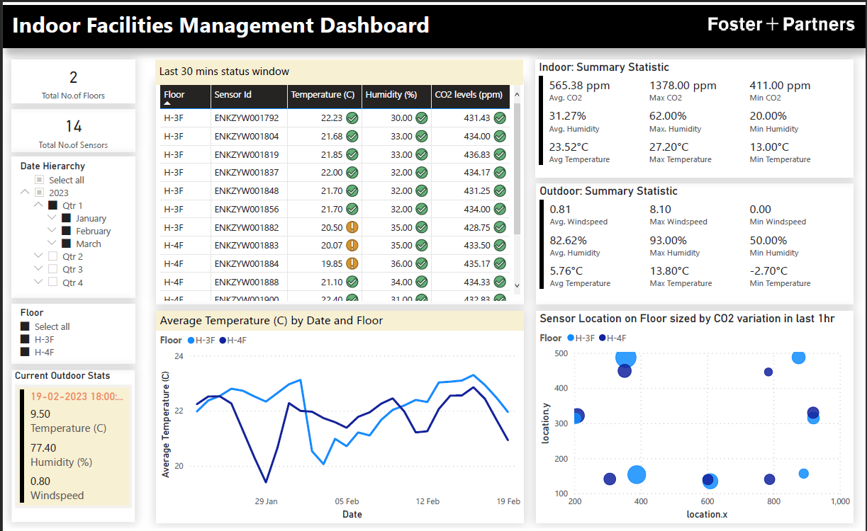

Slide 12
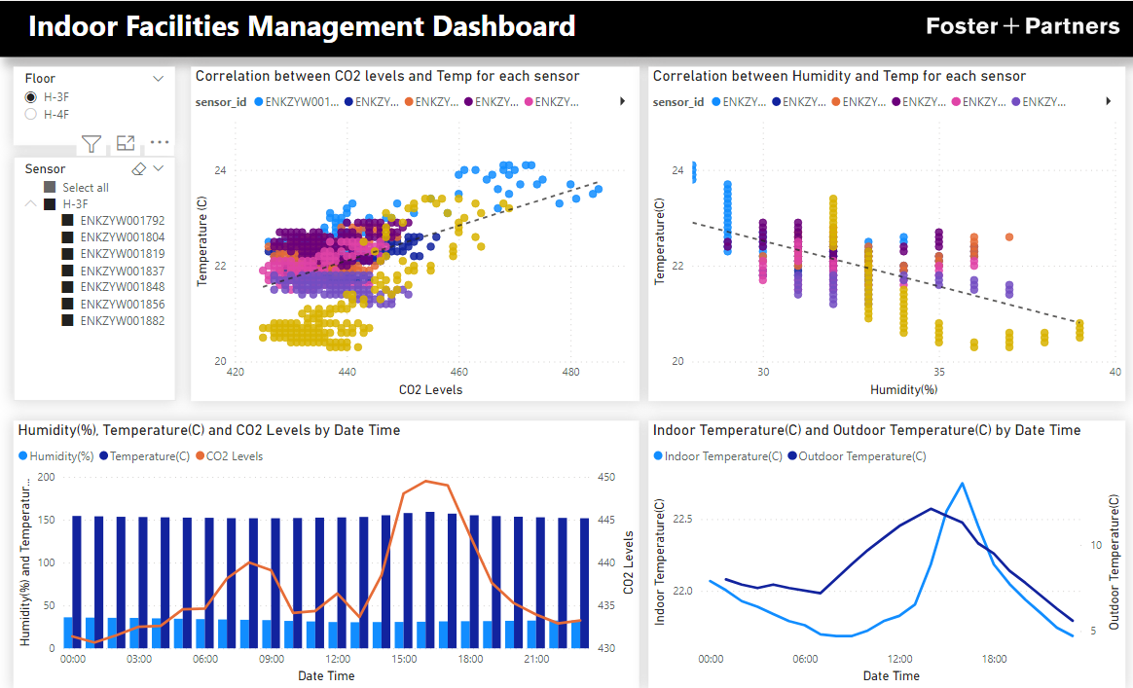

Slide 13
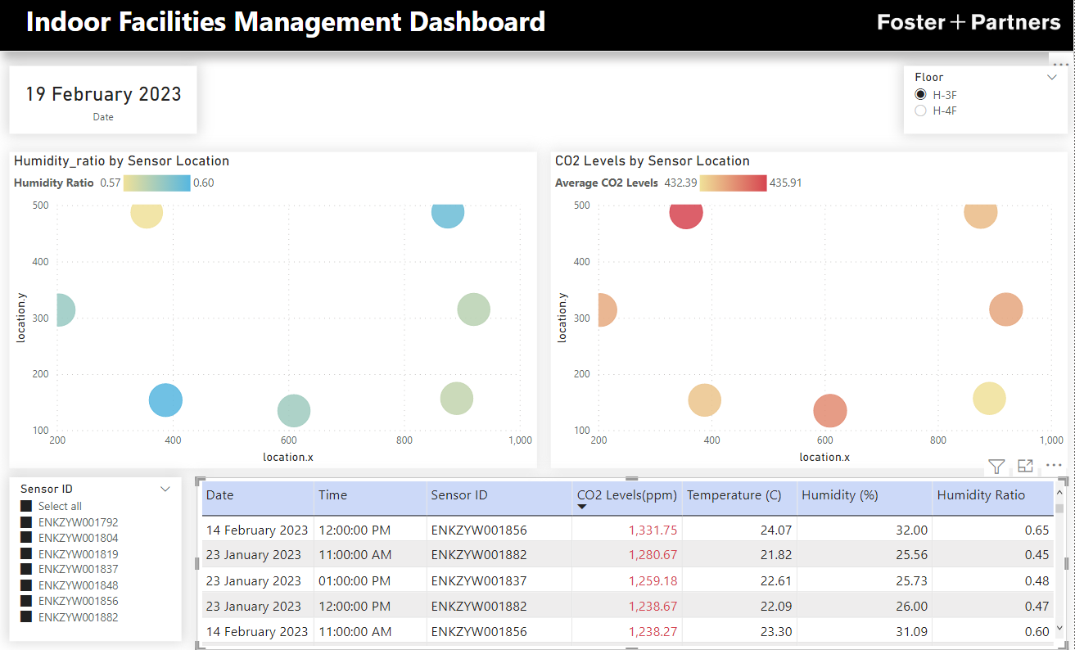

Slide 14
THANK YOU

